Slide 1


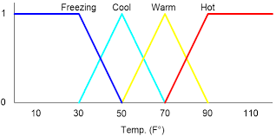
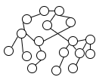
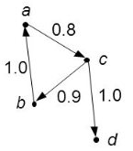
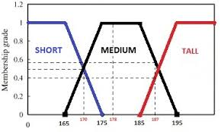

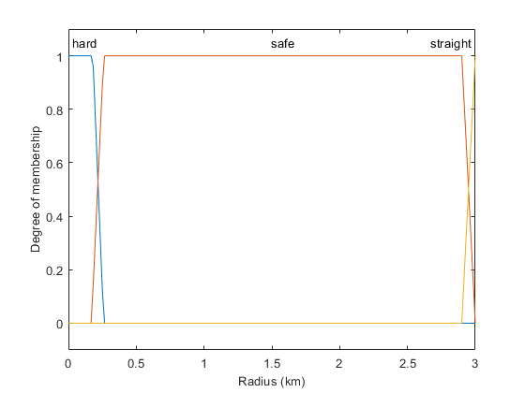

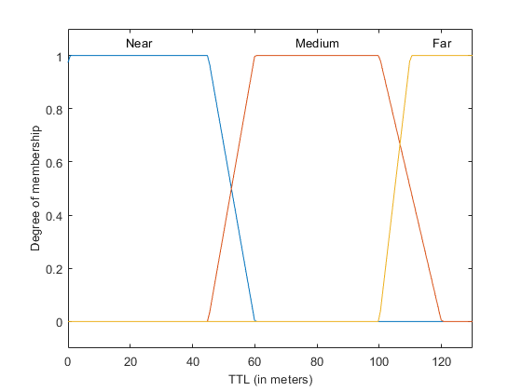
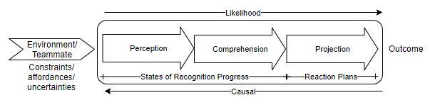
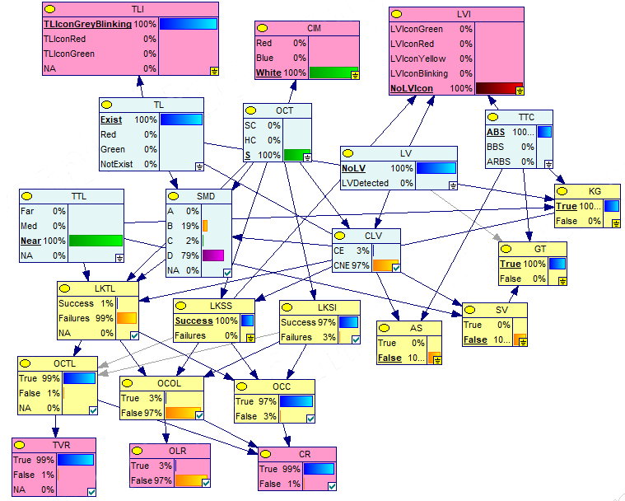
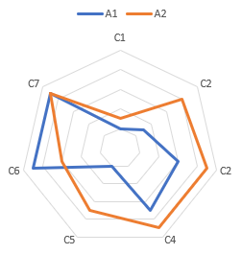
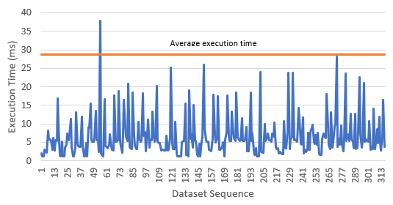
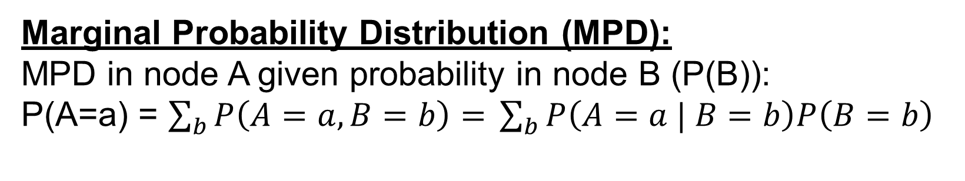
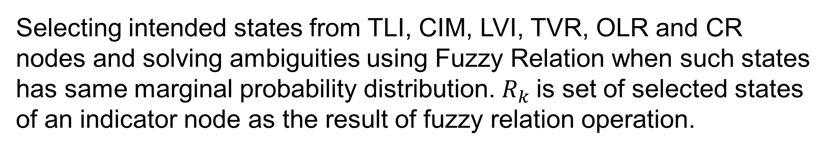
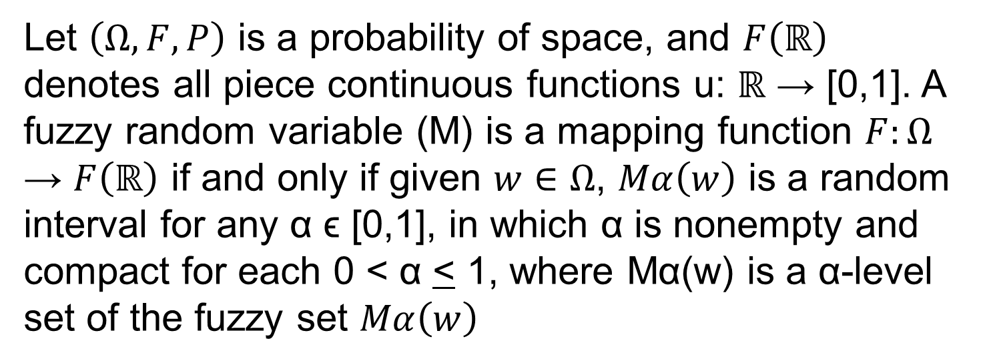
A Fuzzy-Bayesian Based Approach for Intelligent Agent Transparency in Human-Autonomy Teaming
RINTA KRIDALUKMANA | Hai Yan Lu – Mohsen Naderpour
INTRODUCTION
With the advance of artificial situation awareness (SA) technologies, intelligent autonomy agents have been promoted to perform collaborative work with human as a teammate so that a form of human-autonomy teaming (HAT) is established. Such HAT appears in i.e. driving with a car having NHTSA’s Level 3 Automation. The problem is raised as human has over reliance mental model on this agent. Lack of mechanism to comprehend agent’s behavior have been indicated as a contributing factor on such mental model. To mitigate this issue, this study develops an approach to observe agent’s behavior and extract transparency information to assist human comprehension on agent.
Proposed Approach
Step 3
Problem / Question
Materials
Selecting intended states from TLI, CIM, LVI, TVR, OLR and CR nodes and solving ambiguities using Fuzzy Relation when such states has same marginal probability distribution. $R_{k}$is set of selected states of an indicator node as the result of fuzzy relation operation.
Step 1
Step 2
Step 3
Step 4
Fuzzification of task-related object’s states to feed SADP model
Develop SADP model using Bayesian Network (BN)
Selection process on BN’ output states using Fuzzy Relation
Generate linguistic terms using Mamdani’s defuzzification
Step 4
Conveying transparency information about what the agent knows about surrounding object states and its impact on agent’s task-related performance in linguistic terms to be connected to end user presentation
Step 1
P(TVR=True) > 0.8 ⬄ “TL will be violated”
P(OLR=True) > 0.9 ⬄ “Probability of out of lane is high”
P(CR=True) > 0.7 ⬄ “High collision risk detected”
Project Overview
States from intended objects in driving environment such as traffic light, lead vehicle, curve road are collected and transformed into fuzzy sets
Transparency can be described as an effort to provide explanation about why an agent behave like that. This study views that artificial SA development process (SADP) from perception (SA level1), through comprehension (SA level 2), to projection (SA level 3), can reflect agent’s behavior as it plays critical roles on agent’s decision-making process on given situations. Key-transparency information during SADP have been developed as follow:.
Let $\left(Ω,F,P\right)$ is a probability of space, and $F\left(ℝ\right)$ denotes all piece continuous functions u: ℝ → [0,1]. A fuzzy random variable (M) is a mapping function $F:Ω$ → $F\left(ℝ\right)$ if and only if given $w∈Ω$, $Mα\left(w\right)$ is a random interval for any α ϵ [0,1], in which α is nonempty and compact for each 0 < α < 1, where Mα(w) is a α-level set of the fuzzy set $Mα\left(w\right)$
Example Indicator
P(TVR=True) = 0.8
Evaluation
The evaluation criteria is based on the ability to provide transparency information in following theme: agent’s reasoning (C1), reaction plans (C2), likelihood of success on given task (C3), possible outcomes (C4), progress outcomes (C5), perceiving failures (C6). Additionally, the ability to handle uncertainties (C7) is also taken into account.
The comparison result of our proposed approach (A2) with the component-based model (A1) from Lucas (2001):
Step 2
Assign $\left(P\left(X_{i} | Pa\left(X_{i}\right)\right)\right)$ in a root node of the BN with $P(M_{i}|Pa(M_{i})$from step 1:
$$P(X_{i}|Pa(X_{i})) → P(M_{i}|Pa(M_{i})$$
Conclusion
Computational Performance
This study proposes a novel approach by modelling SADP to generate transparency information. The basic principle in SADP model is to capture agent’s perceiving states and examine whether an agent knows every state of necessary related objects and situations affecting agent’s performance on given tasks or not. When the agent fails to recognize a state of objects or situations, it increases the possibility of failures and possible outcomes can be identified.
Data / Observations
Input Data
Behavior Observation
Transparency Indicators
Our proposed approach is good at C2-C5, and a manageable computational performance to produce all information can still be achieved mainly in supporting driving situations (execution time average = 0.028/s).
The proposed approach is suitable for human teammate that can only absorb limited information within limited time due to their tasks in a rapid change environment like in driving.
Real-driving-based data is collected using set of sensors as example of environment states to feed agent’s SADP model
Curve road and traffic light (TL) situations are selected as cases for SADP model
To summarize transparency information, indicator nodes are set for TL states (TLI), curve type (CIM), lead vehicle (LVI), TL Violation Risk (TVR), Out of lane risk (OLR) and collision risk (CR)
Marginal Probability Distribution (MPD):
MPD in node A given probability in node B (P(B)):
P(A=a) = $\sum_{b}{P\left(A=a, B=b\right)= }\sum_{b}{P\left(A=a | B=b\right)P\left(B=b\right)}$
References
Lucas, P.J.F. 2001, 'Bayesian model-based diagnosis', International Journal of Approximate Reasoning, vol. 27, no. 2, pp. 99-119

